Slide 1
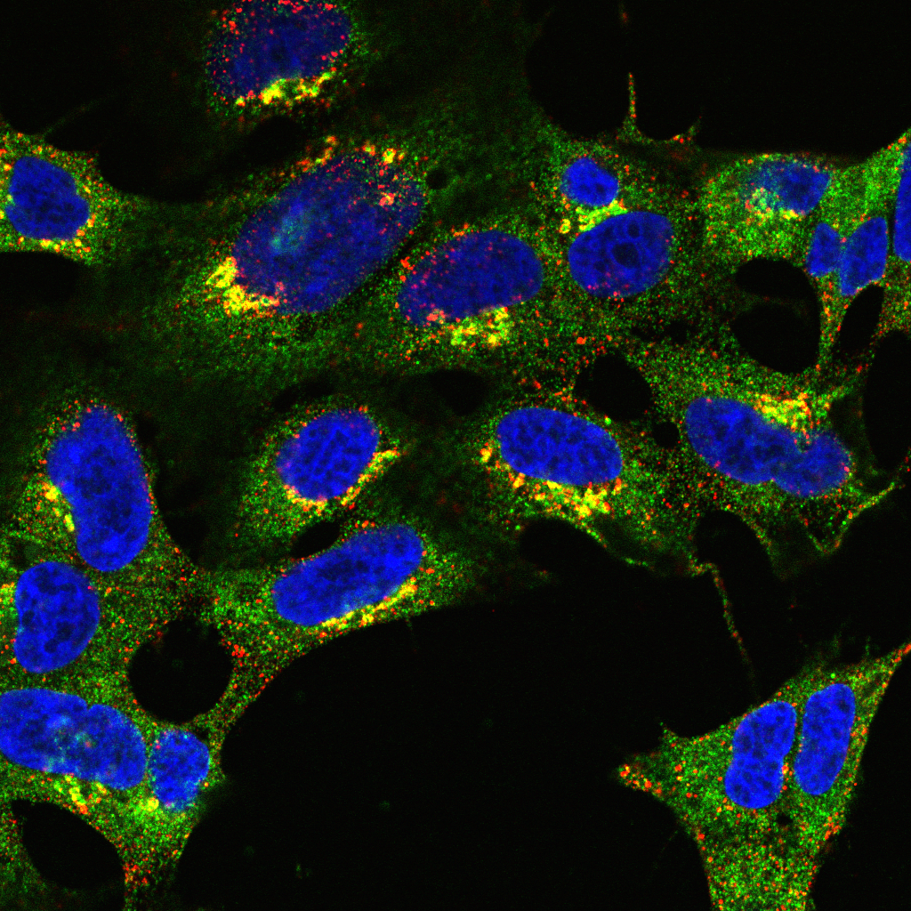
Introduction to colocalisation analysis

Slide 3
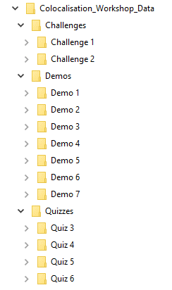
4 Teams
6 Quizzes - 11 Points in Total
2 Challenges - 14 Points in Total

Slide 4
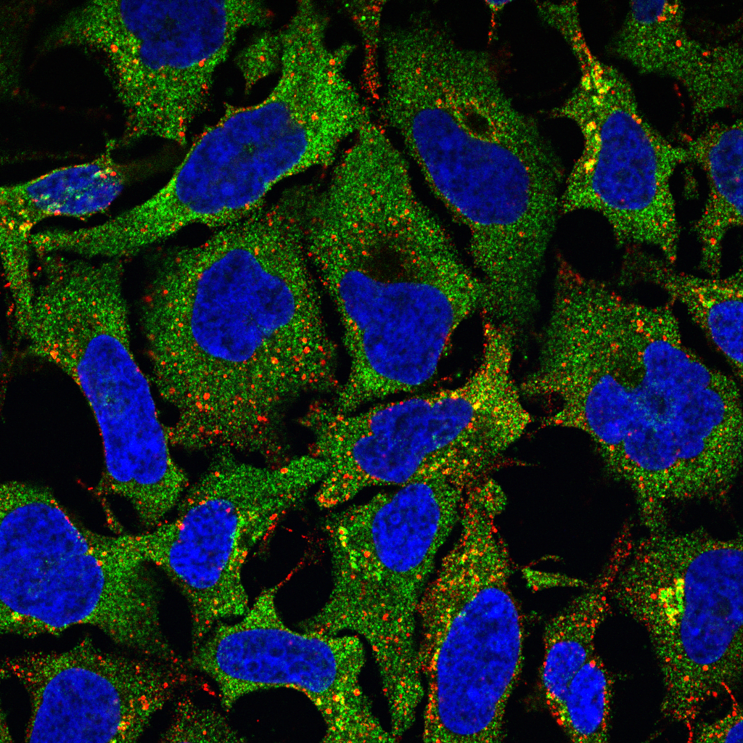
What do we mean by colocalisation?

Slide 5
What do we mean by colocalisation?
Typically refers to one of two things:
Biologists’ Definition: Co-occurrence of two or more proteins
Statisticians’ Definition: Correlation of two fluorescent signals
A
B

Slide 6
Biologists’ assessment often visual
Simplest Case:
Merge two fluorescence pseudo-coloured images
Assess whether different wavelengths are present in same pixels
E.g. Red + Green = Yellow
Problem:
Intermediate colour (e.g. yellow) only visible if probes overlap in similar proportions

Slide 7
“Colour” is highly subjective

Slide 8


Which nucleus is brighter?
Same Intensity

Slide 9
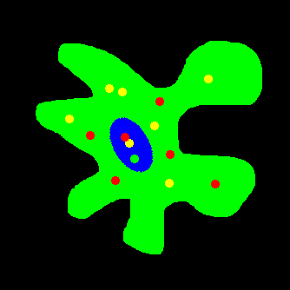
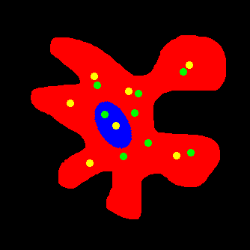
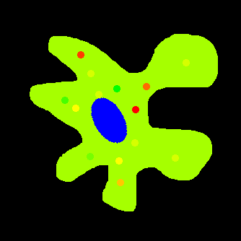

Slide 10

Quiz 1: For 1 Point, How many colours Are There?

Slide 11
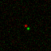
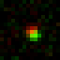
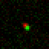

Co-Occurance never actually happens!
8x
There is no such thing as “colocalisation”!
4x
16x

Slide 12
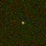
what if DOTs overlap at max resolution?
Fluorophores reside within same volume.
Volume at least one order of magnitude larger than protein complexes

Slide 13
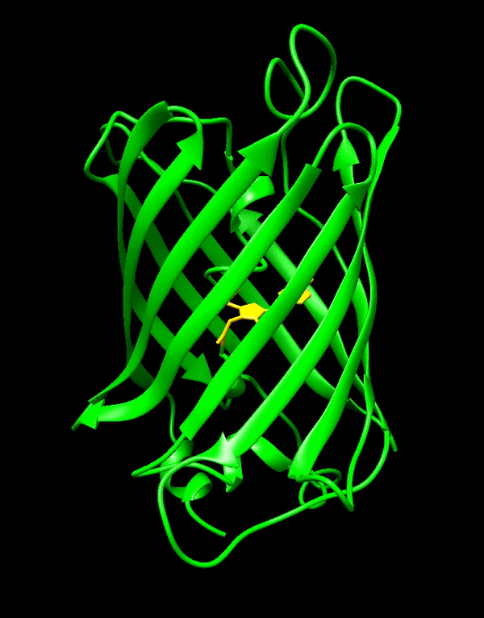
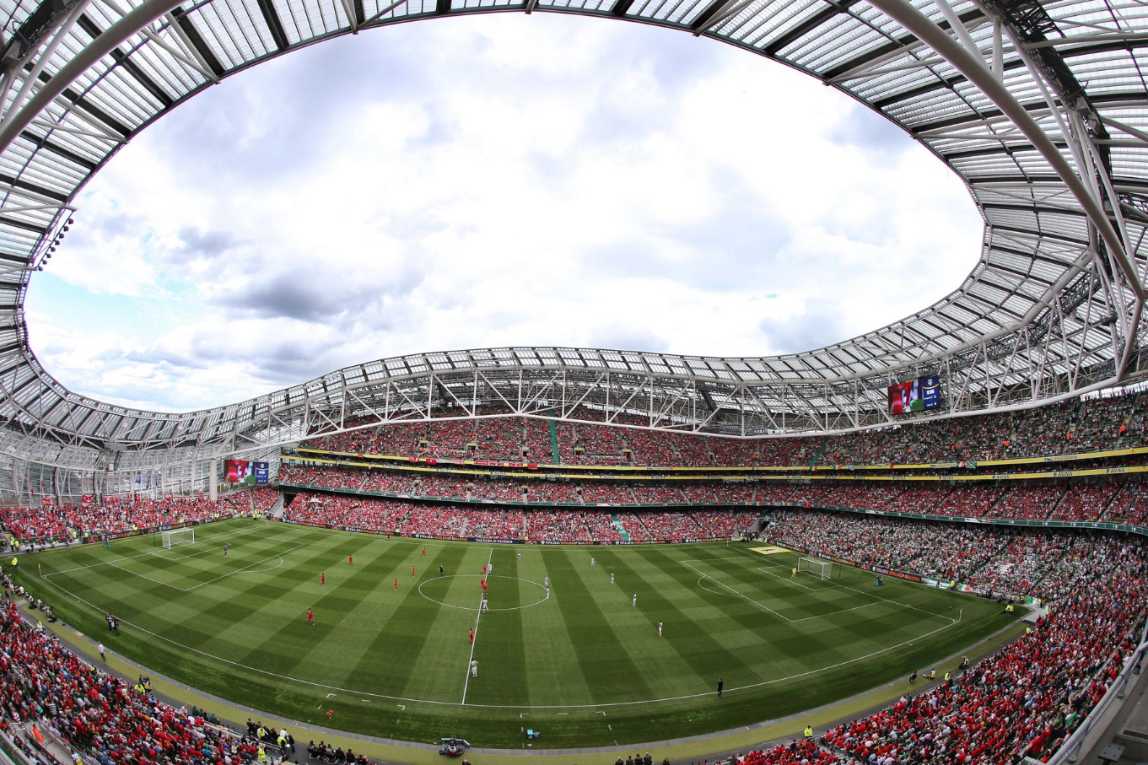
To put that in perspective…
Imaging volume in confocal microscopy approx. 250 x 250 x 750 nm
Imaging volume can accommodate 2,500 GFP molecules!
42 Å
24 Å

Slide 14

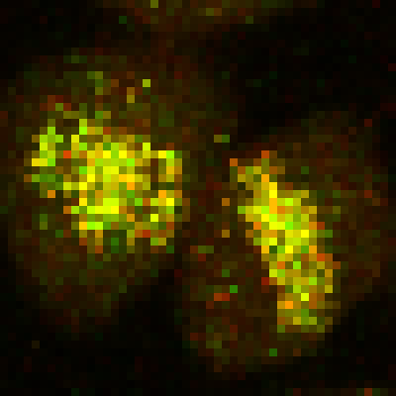
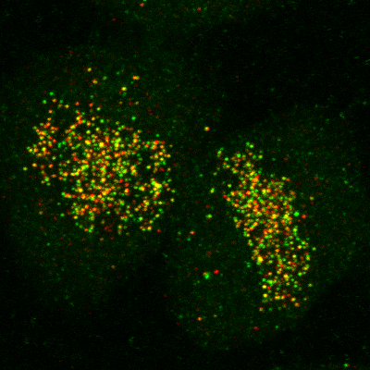
Correlation is not causation
Colocalisation does not imply interaction
Non-colocalisation probably implies no interaction
Dividing line between colocalisation and non-colocalisation is arbitrary
Extent of colocalisation decreases with increasing spatial resolution
Demmerle et al., Nat Protocols, 2017
Relative Localisation
Correlation Analysis

Slide 15
Quiz 2
For 1 point, which of the following determines the resolution of an image?
Magnification
Image size
Pixel size
Microscope type (widefield, confocal, light-sheet, etc.)
None of the above

Slide 16
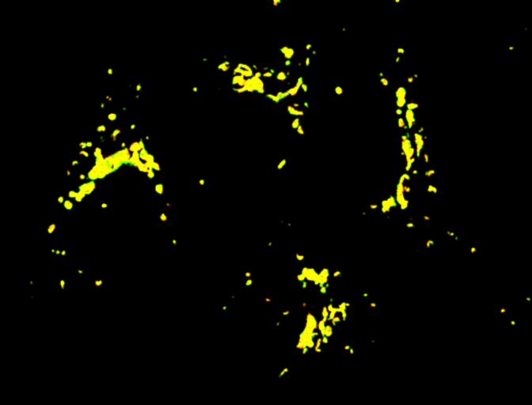
“Colocalisation” means different things to different people
Red + Green = Yellow?
Co-occurrence:
Molecules present in a region
No concentration relationship
Correlation analysis:
Stoichiometric relationship between molecules
No spatial information
A
B

Slide 17
Common sources of error

Slide 18
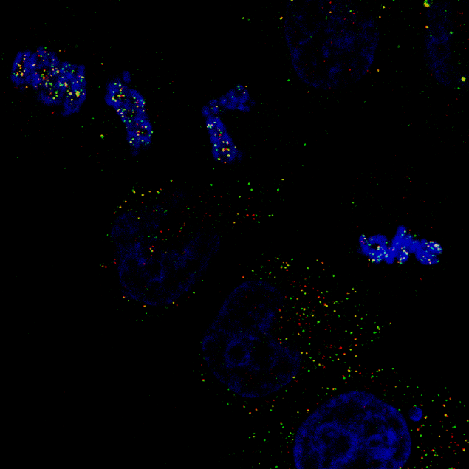
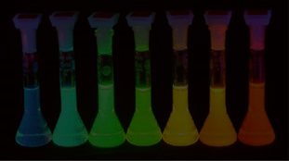
Potential pitfalls
Probes:
Signal is sufficient to distinguish from noise and background
Uncontaminated by auto-fluorescence
Free of signal bleed-through
Image:
No lossy compression
Not saturated / clipped / overexposed
Spatial resolution sufficiently high

Slide 19
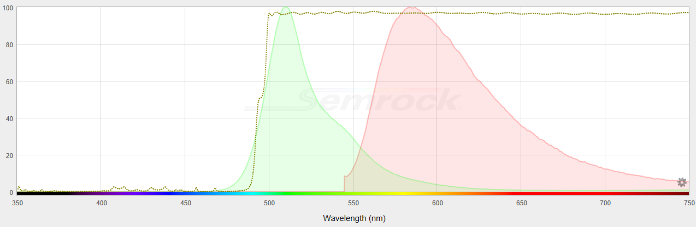
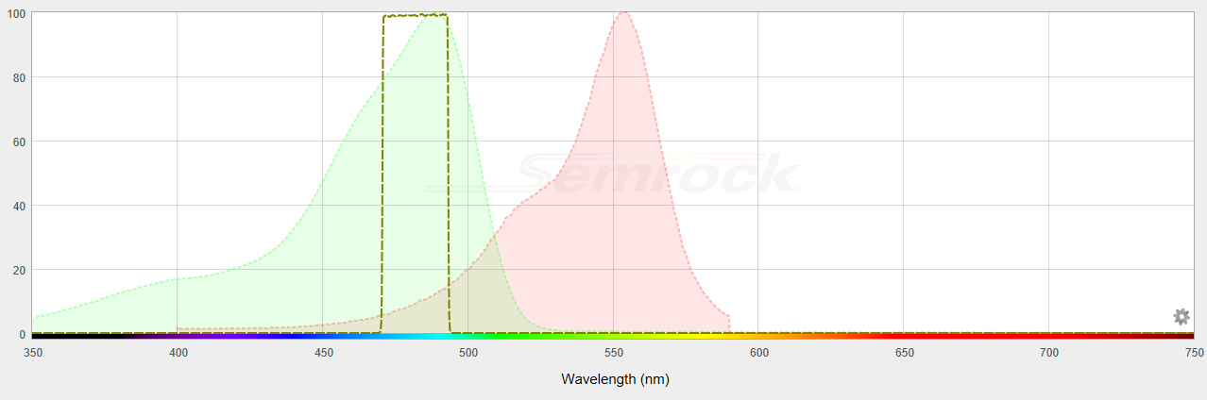
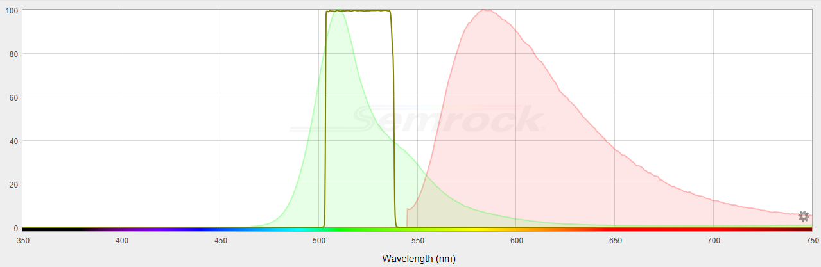
Avoiding bleed-through
Maximizing excitation and emission collection should be balanced with minimizing bleed-through
Emission
Filter
Excitation
Filter
GFP
GFP
RFP
RFP
https://searchlight.semrock.com/

Slide 20
Chromatic aberration
Waters, JCB, 2009

Slide 21

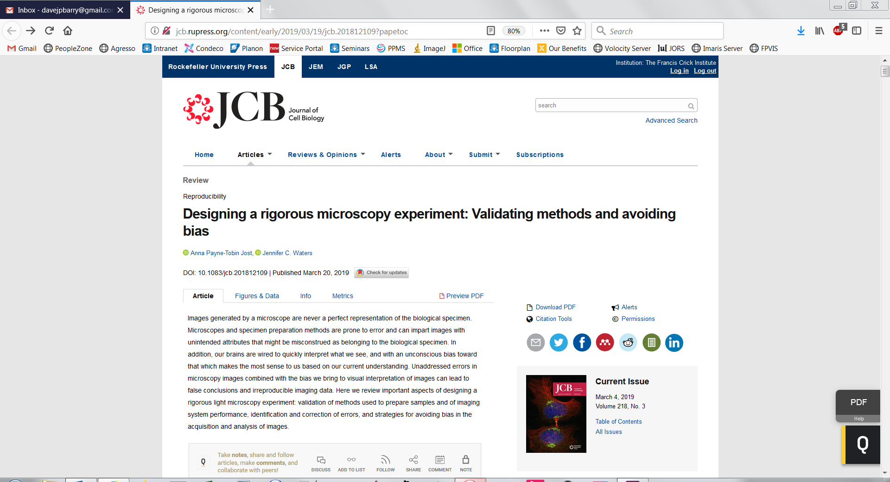


Slide 22
What is Quantitative Colocalisation?
“Under the conditions of proportional co-distribution, points of the scatterplot cluster around a straight line, whose slope reflects the ratio of the fluorescence of the two probes.”
Dunn et al., Am J Physiol Cell Physiol, 2011

Slide 23
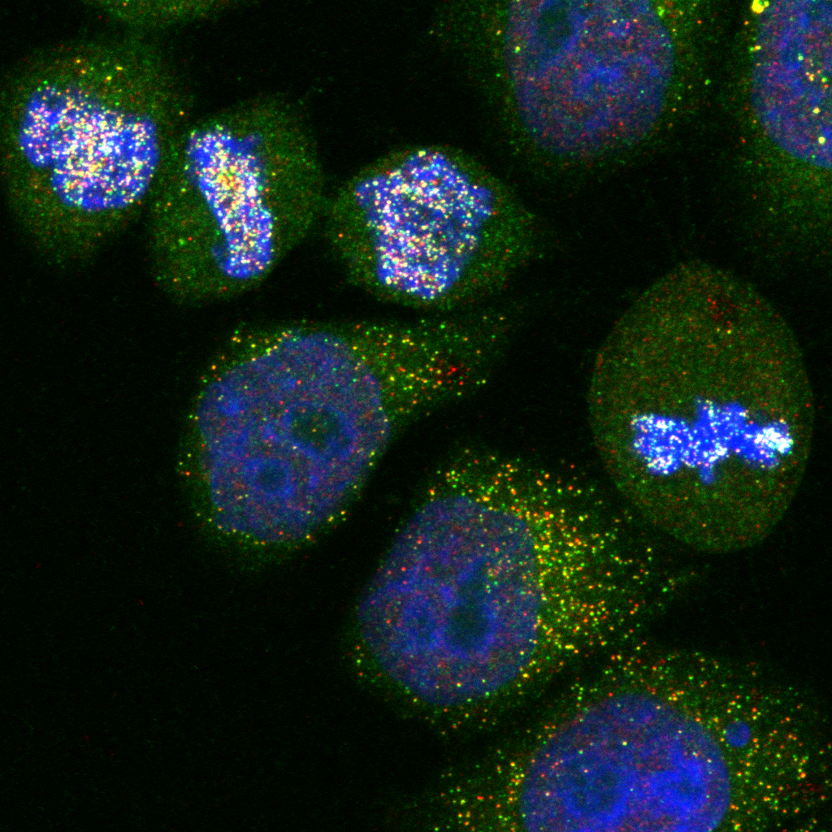
Two criteria must be met:
Co-occurrence - spatial overlap of probes
Correlation - probes are co-distributed
Distribution may overlap, but not proportionally
DAPI will overlap with nuclear proteins, but will unlikely be proportional

Slide 24
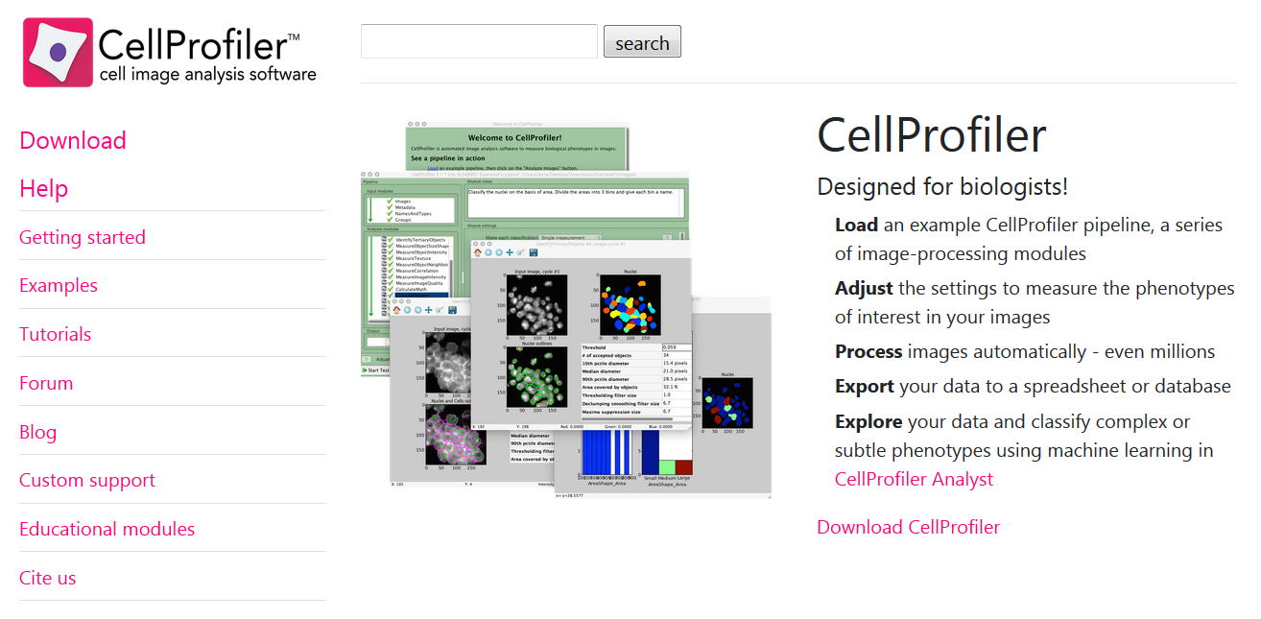
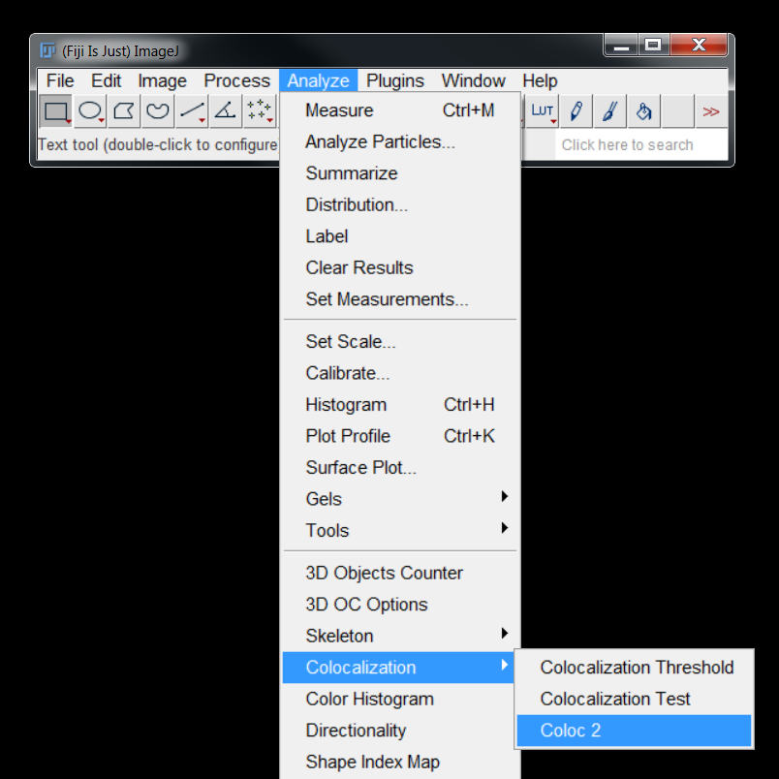
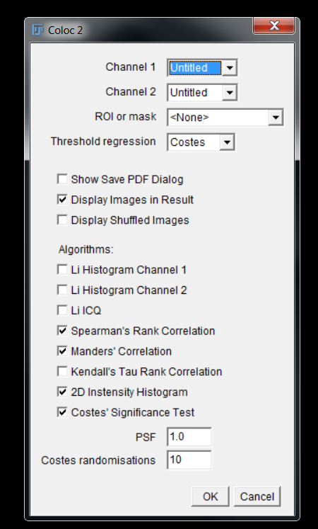
COLOC2 – FIJI Plugin for colocalisation analysis

Slide 25
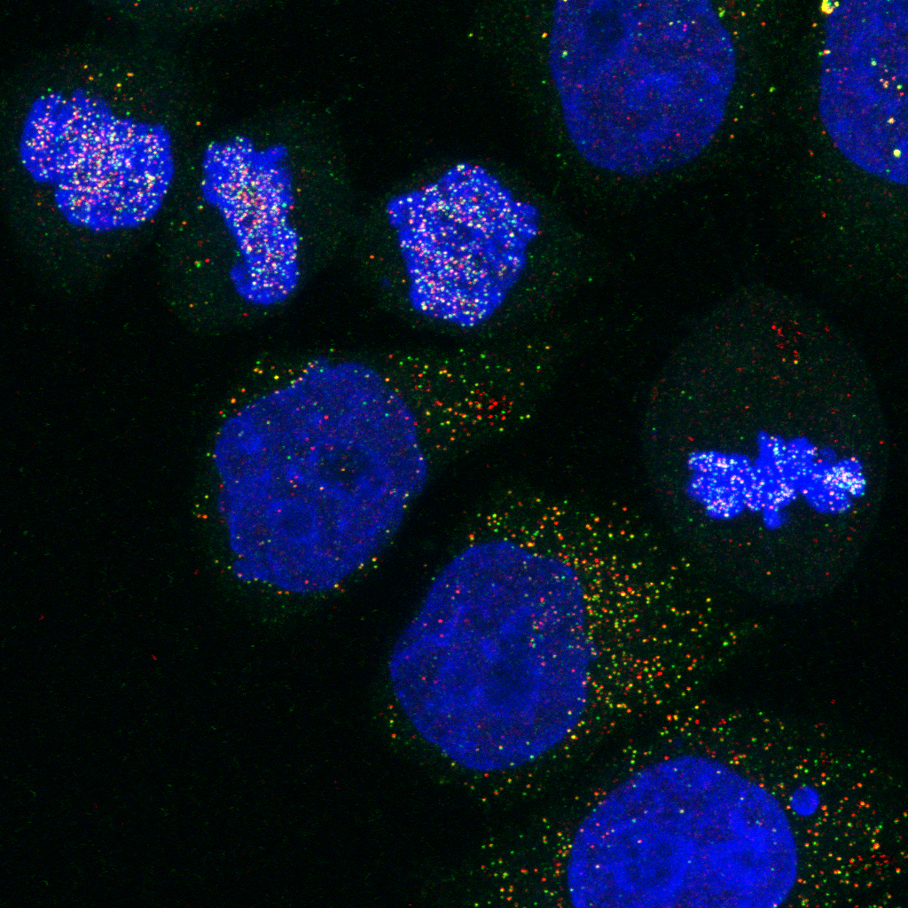
The Importance of controls

Slide 26
Controls
Correlation coefficients mean little in isolation
Analyses should include positive and negative controls
But, control samples may not exist
Practical alternative: generate a “random” distribution by scrambling, translation or rotation.

Slide 27
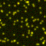
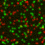
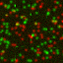
Generating controls
Original
Rotated 90°
Randomised
P = 0.95
P = -0.06
P = 0.00

Slide 28
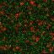
Things to consider when generating controls
Original
Random Noise
P = 0.95
P = 0.00
Spatial Autocorrelation: the value of one pixel is likely to be similar to that of its neighboring pixels.
Most indicate a block size should be the size of the PSF
Should equal or exceed the size of the objects in an image

Slide 29



Crick Advanced Light Microscopy ● SW302 ● david.barry@crick.ac.uk

Slide 30
Useful References
https://dx.doi.org/10.1083/jcb.200903097
https://dx.doi.org/10.1073/pnas.1711314115
https://dx.doi.org/10.1152/ajpcell.00462.2010
https://doi.org/10.1111/j.1365-2818.2006.01706.x
https://doi.org/10.1529/biophysj.103.038422
https://doi.org/10.1242/jcs.211847
https://doi.org/10.1371/journal.pone.0111983
https://doi.org/10.1038/nmeth.3587

